Slide 1
What are the drivers for Americans’ Healthcare Cost
Presented by
Brian Jemison, Honghong Zhang,
Ling Luo, Indra Merai

Slide 2
Introduction
What factors impact healthcare cost in the United States?
Gather historical data from reliable data source for the years 2010 to 2014 for the 50 states and the capital for their healthcare spend per Capital.
Explore the drivers/factors that affect the healthcare expenditure.
Formularize the simplify model that fit those drivers to explian healthcare spend .
Notes:
How presentation will benefit audience: Adult learners are more interested in a subject if they know how or why it is important to them.
Presenter’s level of expertise in the subject: Briefly state your credentials in this area, or explain why participants should listen to you.

Slide 3
Project Outline
Healthcare Expenditure Data Collect
Historical data from reliable data source for the years 2010 to 2014 for the 50 state the healthcare spend per capital.
Factors Exploratory Analysis
Start from exploratory analysis with the variables that affect the healthcare spend.
Explain Healthcare Spend Statics Model
Identify the drivers and fit those factors into the Linear Regression Model.
Notes:
Lesson descriptions should be brief.

Slide 4
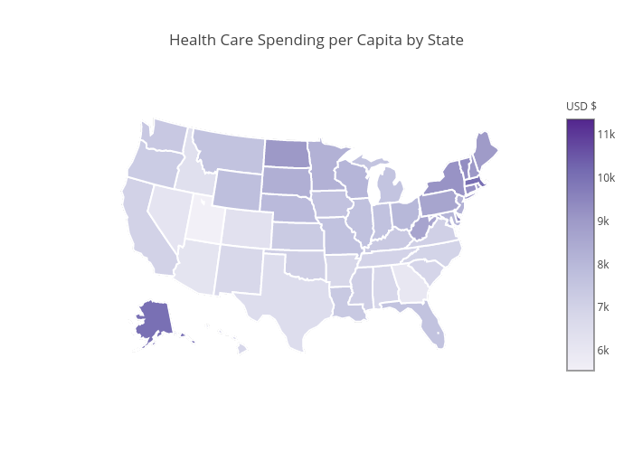
Step1: Healthcare Expenditure Exploration
Identify the data source;
Gather the data;
Clean the data.
From 2010-2014, Massachusetts, Alaska and Delaware on average ranked highest for healthcare expenditures.
Utah, Georgia and Nevada ranked lowest.

Slide 5
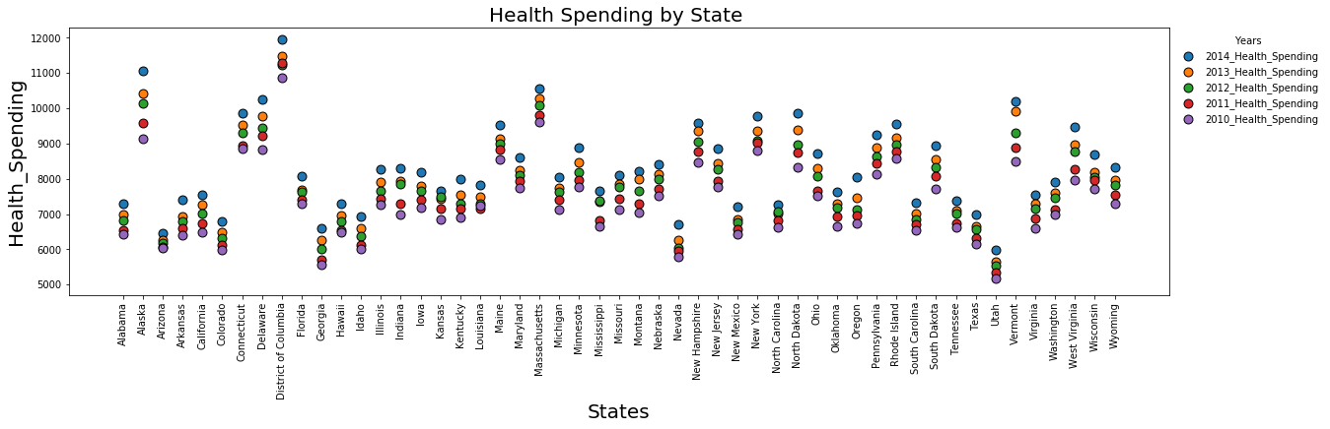
Step1: Healthcare Expenditure Exploration
In general, northern states had higher healthcare expenditures than states further south.
Washington D.C. (although not a state) had the highest overall healthcare expenditures in the country.

Slide 6
Step 2: Drivers/Factor Exploratory Analysis
Smoking Population Percentage per State ;
Household Income;
Gross Domestic Product of the state;
Gender Distribution Percentage per State ;
Age Distribution Percentage per State -Childhood (0–19), Young adult (20–39), Middle-aged adult (40–64) and Senior years (65-84)

Slide 7
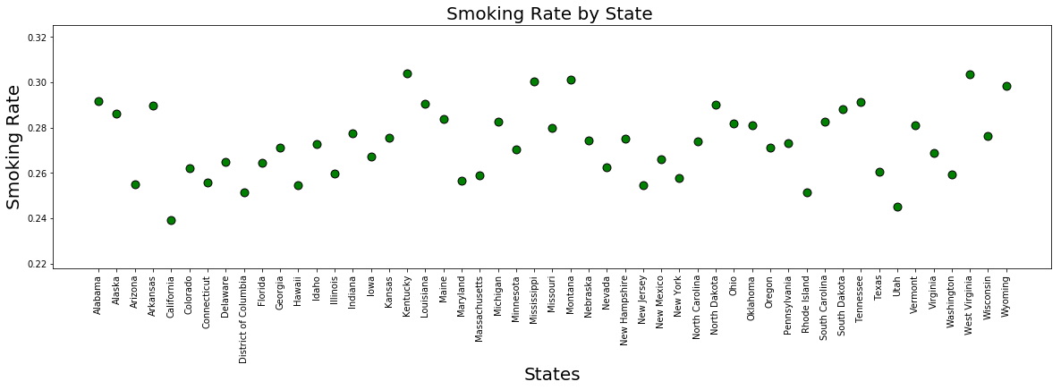
Step 2: Smoking Population Percentage
The overall smoking rate between 20-30%
There is some fluctuation of smoking rate among different states, for example, Kentucky has higher rate over 30%, California has the lowest rate of 24%.

Slide 8
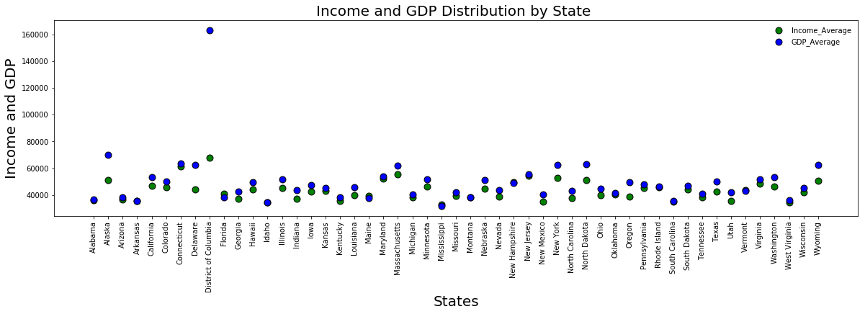
Step 2: Household Income & GDP per State
The states have similar trend of GPD and Income amount, except District of Columbia
There is difference of GDP and Income data among different states, from around 4,000 to 7,000

Slide 9
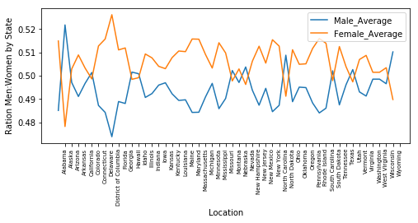
Step 2: Gender Distribution Percentage per State
There is no much differences for the gender by states,
almost 50% to 50%, although female is a little bit higher than male.

Slide 10
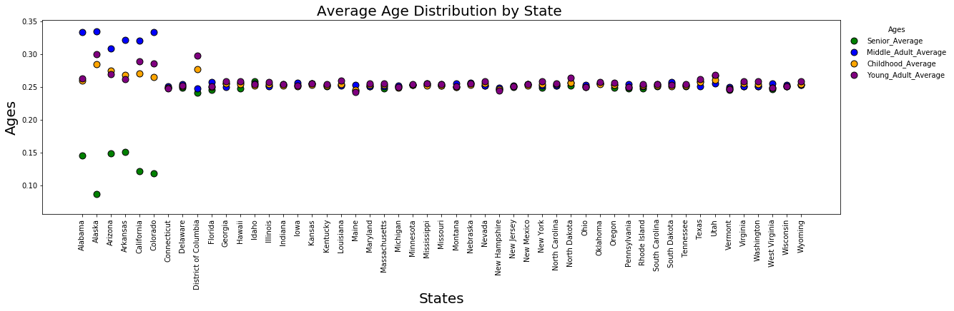
Step 2: Age Distribution Percentage per State
States of Alabama, Alaska, Arizona, Arkansas, California, Colorado have different age group structure,
middle age adult is more than senior people.
Other states have similar age groups, each is 25%.

Slide 11
Step 2: Wrap-up
The data was gathered from these sites:
The Henry J. Kaiser Family Foundation (https://www.kff.org)
Centers for Disease Control and Prevention (https://www.cdc.gov/brfss/index.html)
U.S. Government’s open data (https://www.data.gov)
American Fact Finder (https://factfinder.census.gov/faces/nav/jsf/pages/index.xhtml)
In summary:
As a group we decided on a disease or unhealthily habit as a factor that would drive the cost of the health care up, but data analysis show that there is not a strong correlation between tobacco smoking and healthcare expenditures.
Age distribution average across all states except for a few are pretty much the same across the four tier in our data.
Gross Domestic Product and household income for all states is within a very small range difference, except when you factor in District of Columbia.

Slide 12
Step 3: Model Fit Exploratory Analysis
Scatter Plot Healthcare Spending with different variables
Run Linear regression Models to test the statically significance
Select the OLS Model to explain the Expenditure of Healthcare

Slide 13
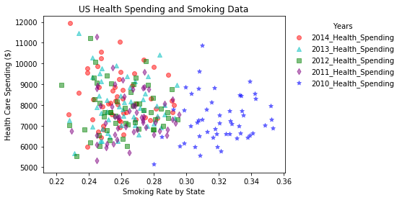
Lesson 3: Scatter Plot With Smoking Percentage
By looking the chart of: Smoker population percentage and the Healthcare spending, the correlation of those are very random: the lower smoker population percentage doesn’t means the lower health spending.
Overall, the smoker population shows downtrend over those years

Slide 14
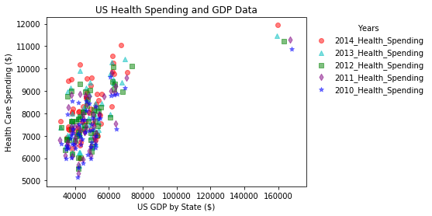
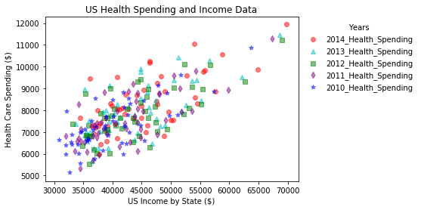
Lesson 3: Scatter Plot With GDP & Income
Healthcare spending shows strong correlation with the GDP.
Similar trend with GDP, the Healthcare spending has the strong positive relationship.

Slide 15
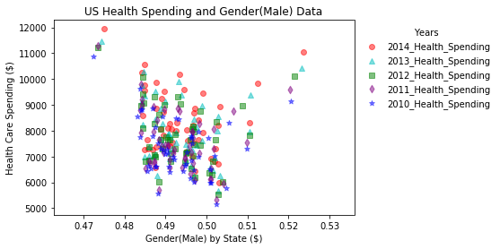
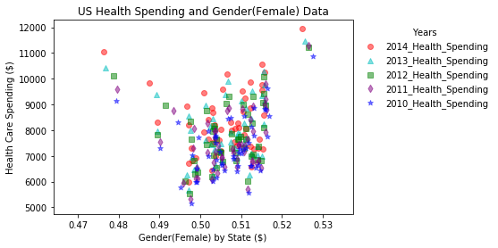
Lesson 3: Scatter Plot With Gender Distribution
The relationship between healthcare spend with Gender distribution has the bell shape ,not the linear –showing the more balance of the gender , the less of the spending.
The healthcare expenditure shows the uptrend over the years.

Slide 16
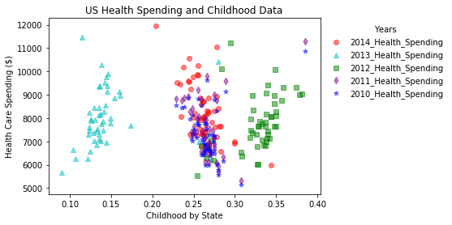
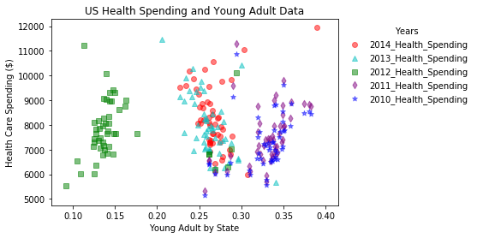
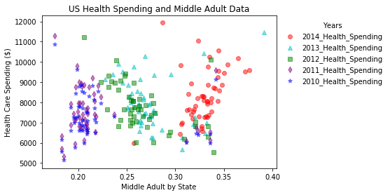
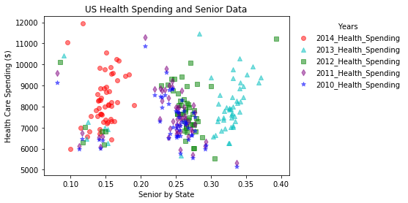
Step 3: Scatter Plot With Age Group

Slide 17
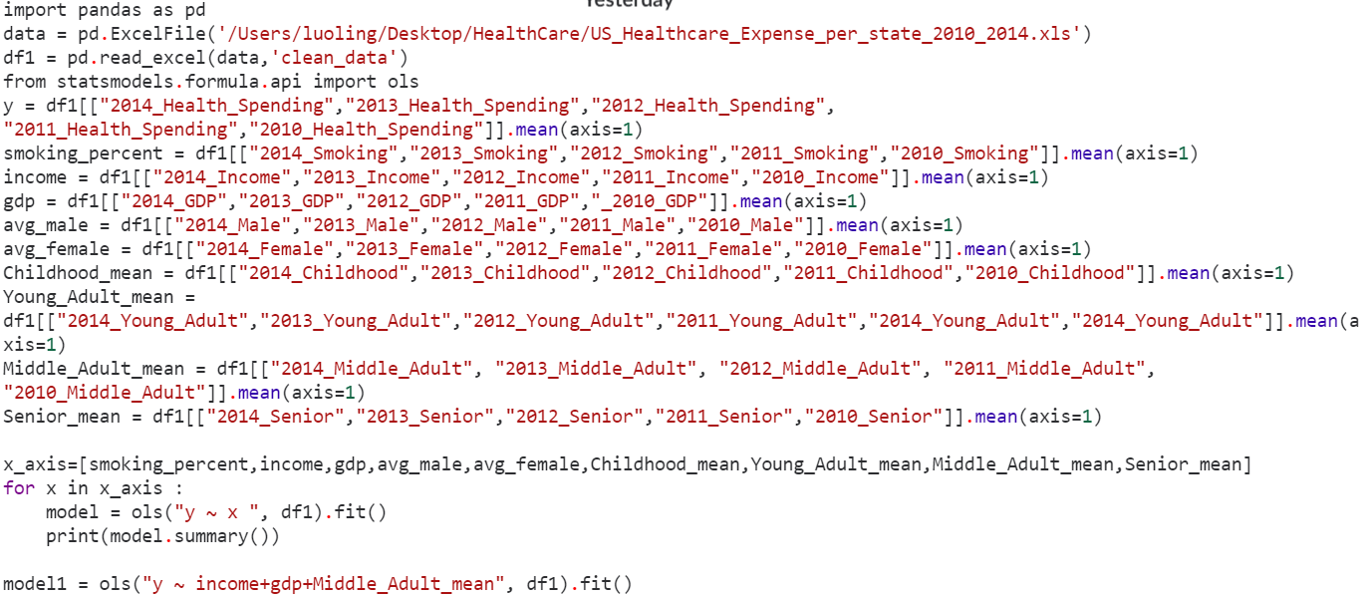
Step 3: Regression Statistic Model Analysis

Slide 18
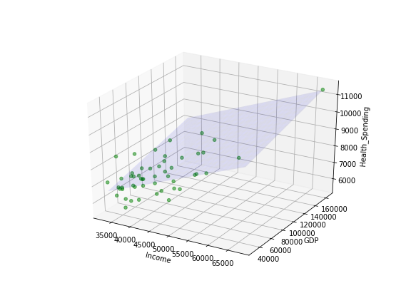
Step 3: Regression Statistic Model Analysis-Chart
After run the multiple variances linear, we selected the Income, GDP and Middle-age Group percentage as the explanation drivers for the healthcare spending also those factors can be used as the indictors to forecast the expenditures.

Slide 19
Summary of Analysis & Limitations
Surprise results:
Middle-age group has the strongest correlation with the healthcare spend;
Gender distribution didn’t relate to the healthcare spend;
Income and GDP correlated with the healthcare spend positively.
Limitations and Improvement.
GDP & Income may has the multicollinearity;
Besides of the linear relationship, drivers may have other Stat relationship;
Other drivers may be missed.

Slide 20
Any questions, concerns or suggestions?

